Slide 1
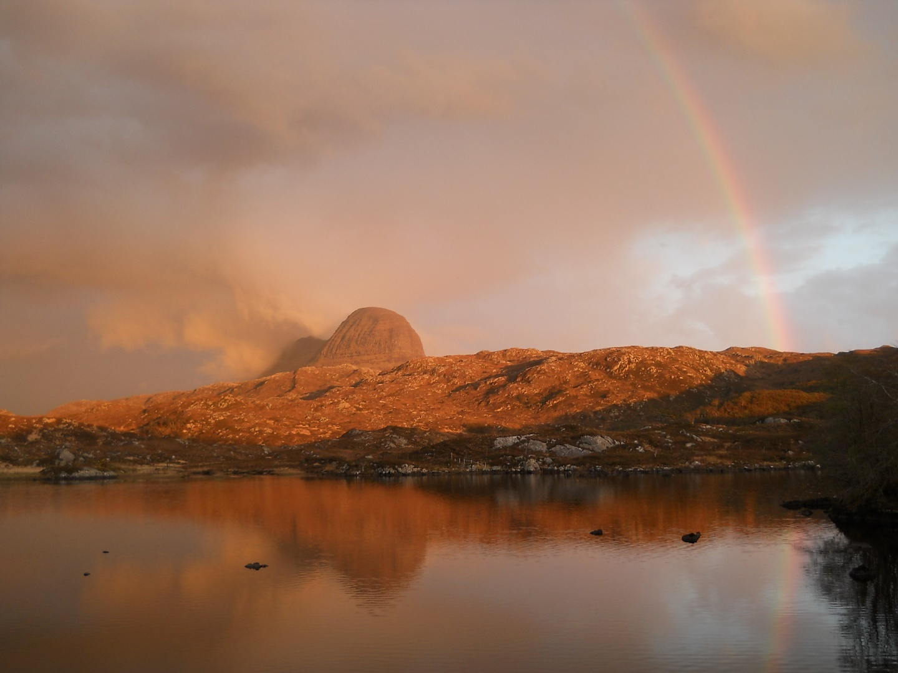
EASTER IN SCOTLAND 1971-2021

Slide 2
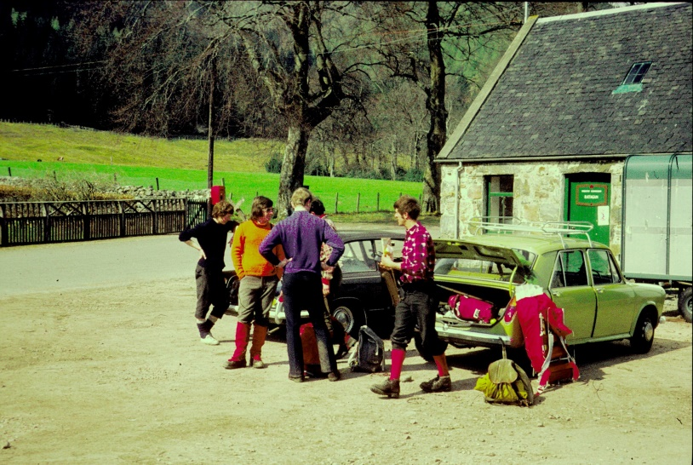
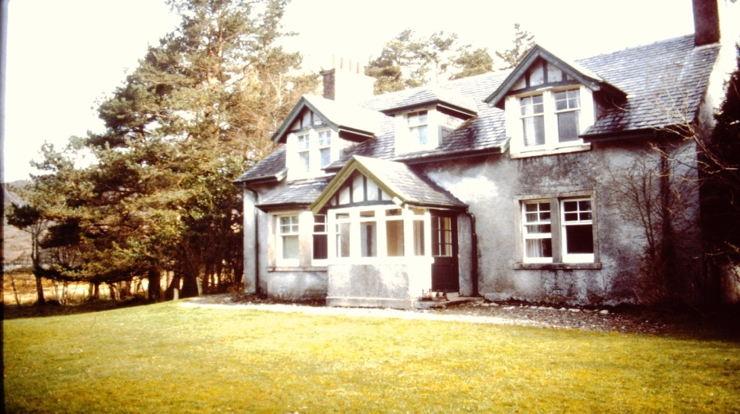
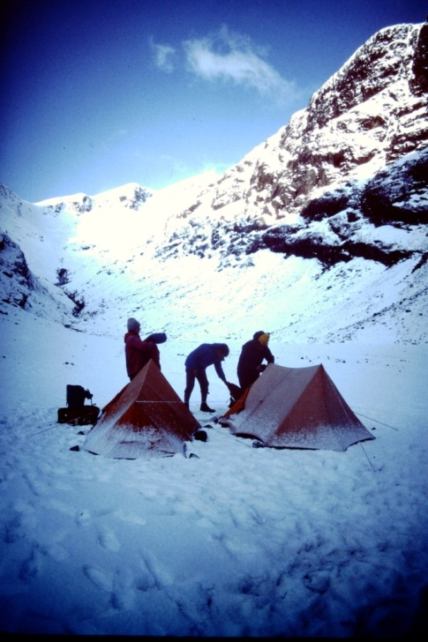
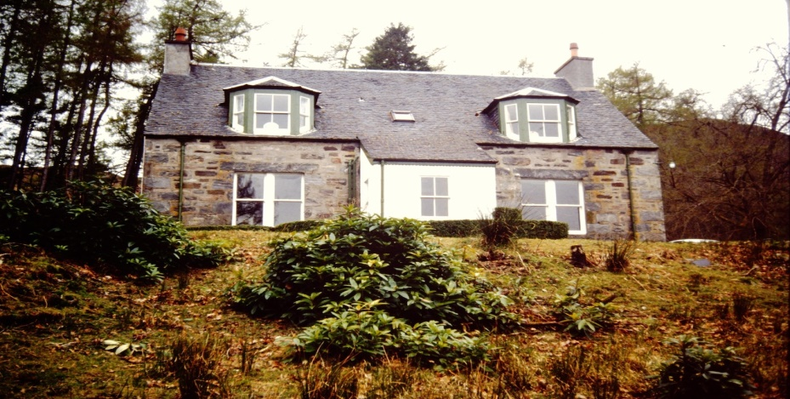
Accommodation – from tents to castles
1970s – Ratagan Youth Hostel
1984 - Carron Lodge
- Hidden Valley, Glencoe
1992 - NonachLodge

Slide 3
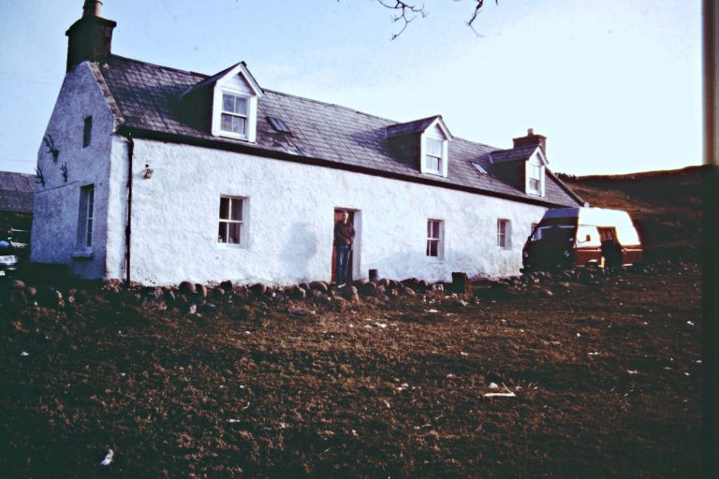
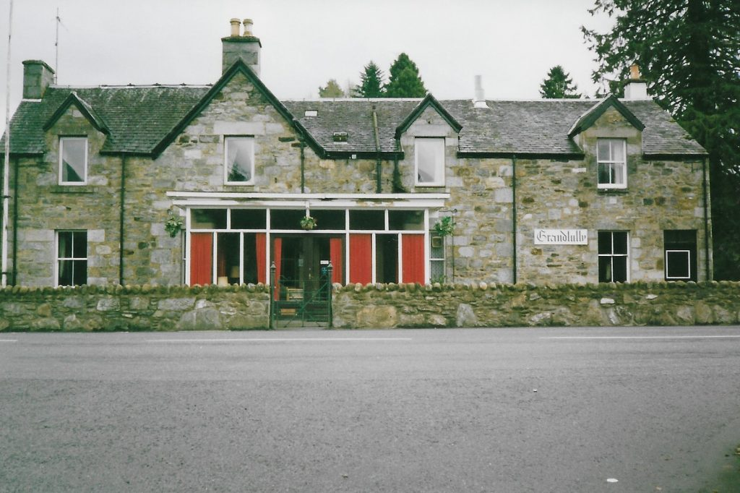
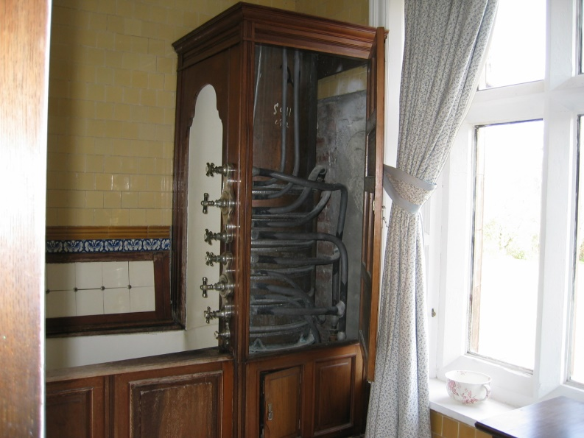
1998 – Druinard (Stoer)
2004 - Grandtully
2009 Kinlochmoidart House – Victorian shower

Slide 4
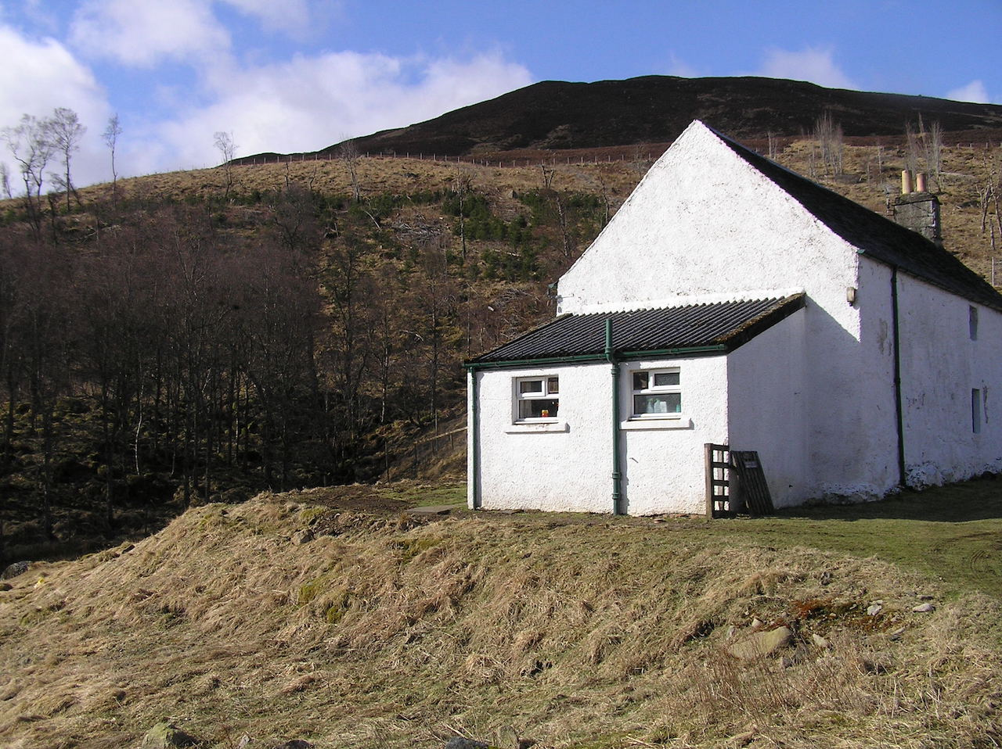
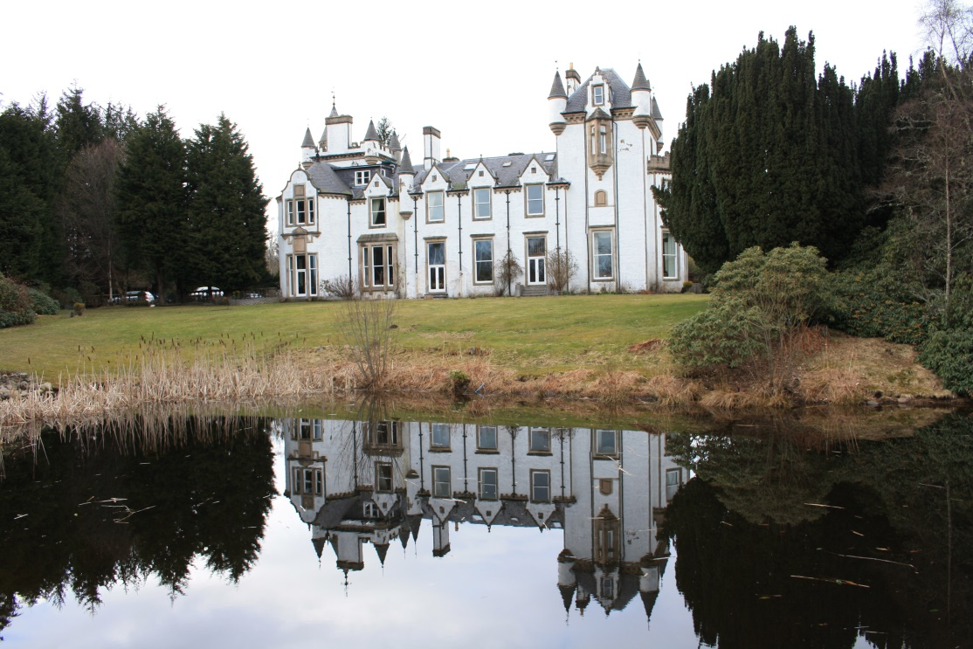
2010 – Glenshee
Some of us stayed in small cottages including the famous ‘hovel’…..
……whilst others mixed with royalty at Dalnaglar Castle
We revisited Dalnaglar in 2018

Slide 5
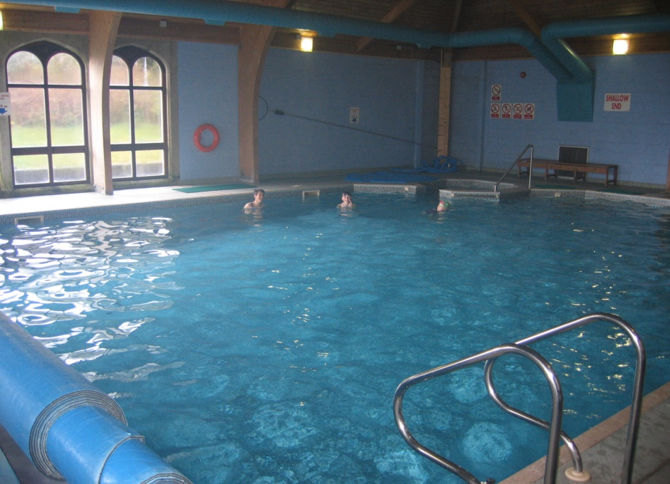
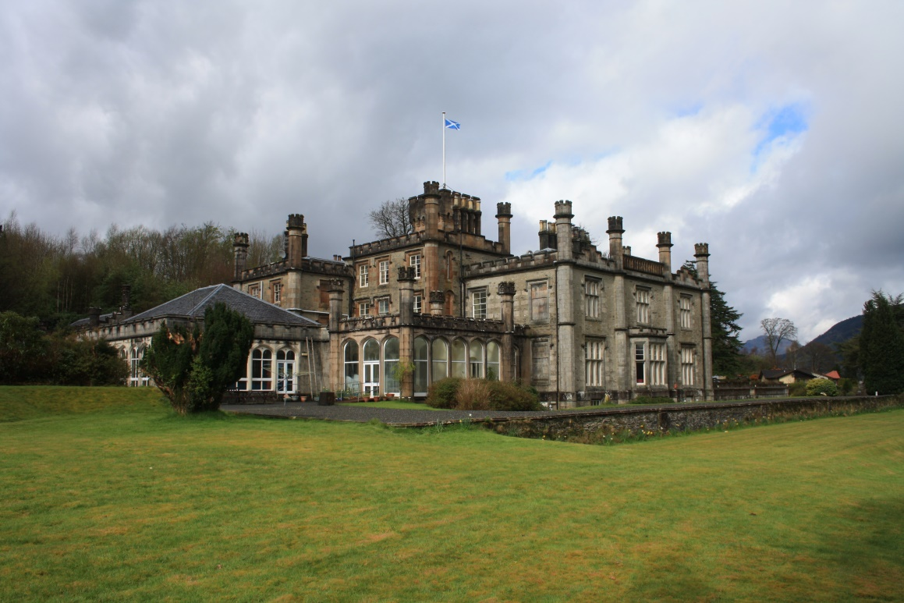
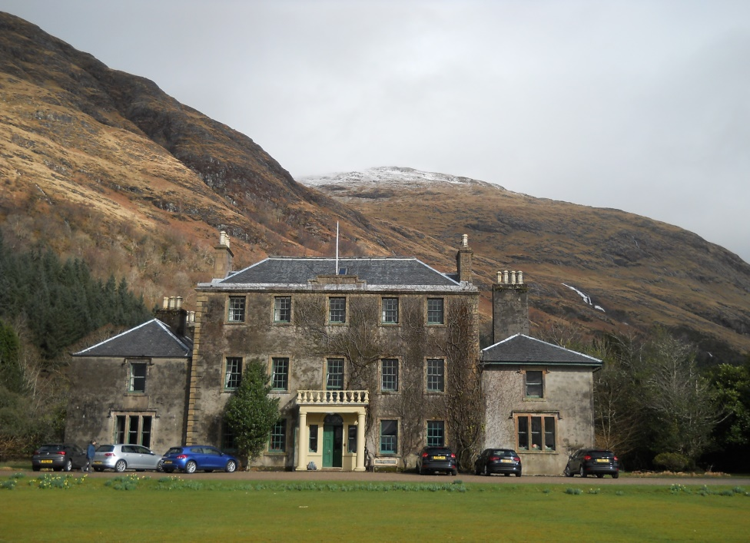
2012 – Dunoon – with indoor pool
2016 Ardgour House, Corran

Slide 6
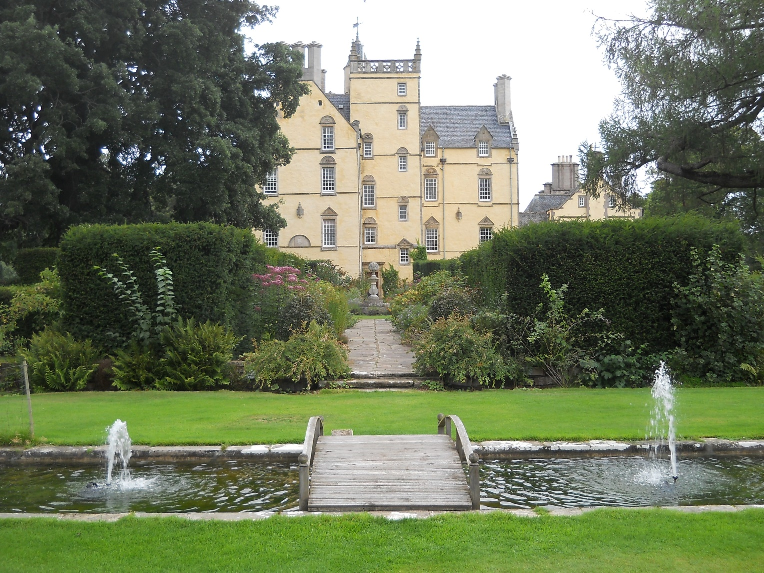
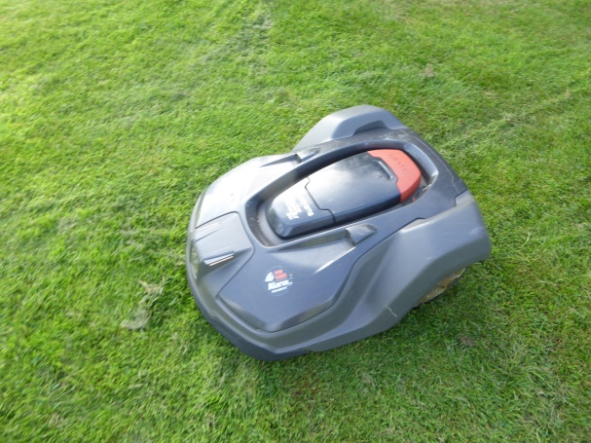
2021 (“Eastember) – Innes House

Slide 7
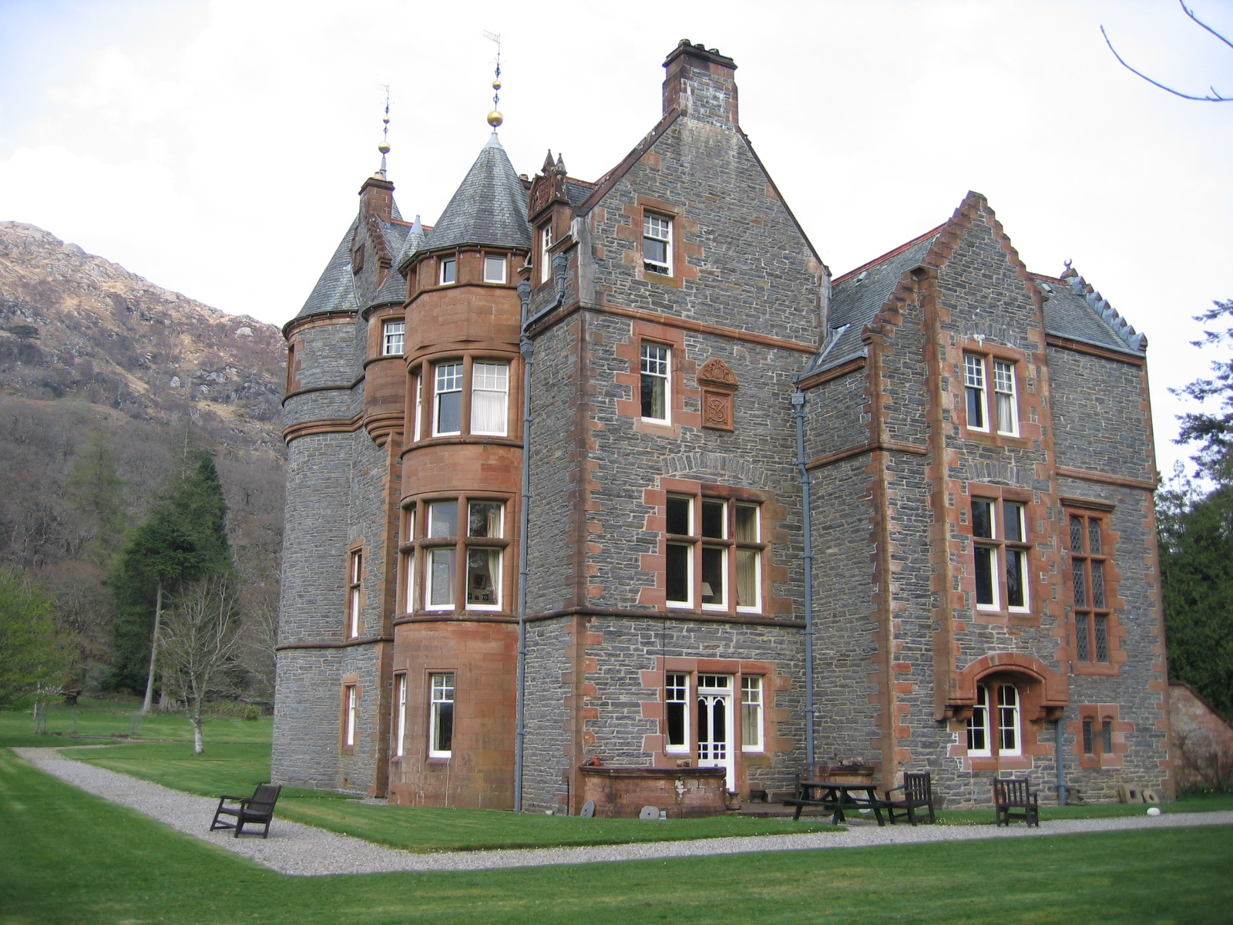
2023 - Kinlochmoidart

Slide 8
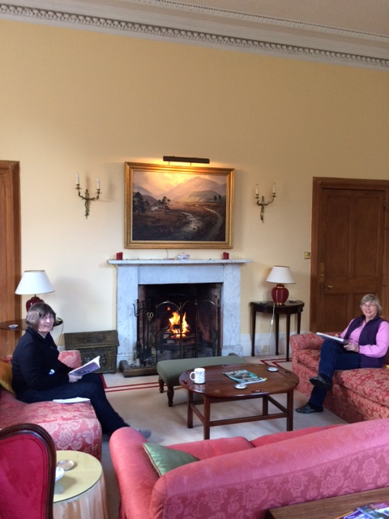
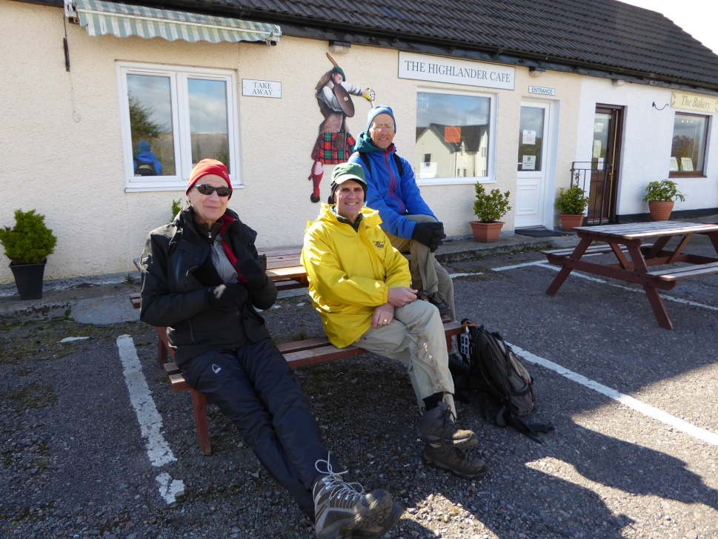
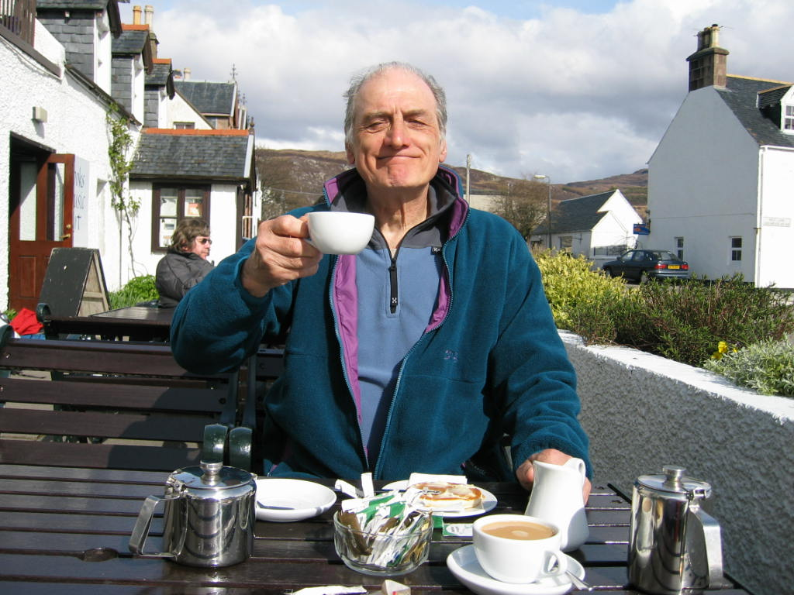
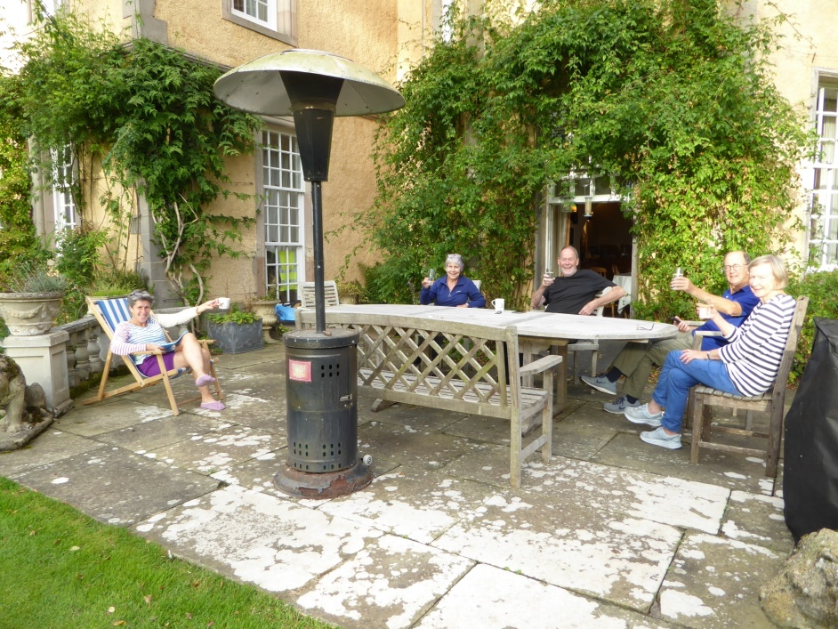
Easter activities
Afternoon Tea …. Or G and T

Slide 9
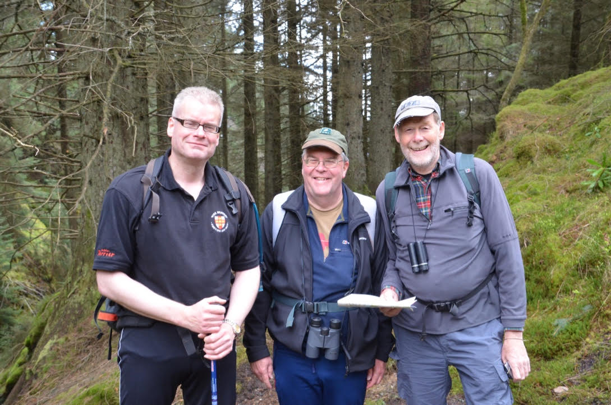
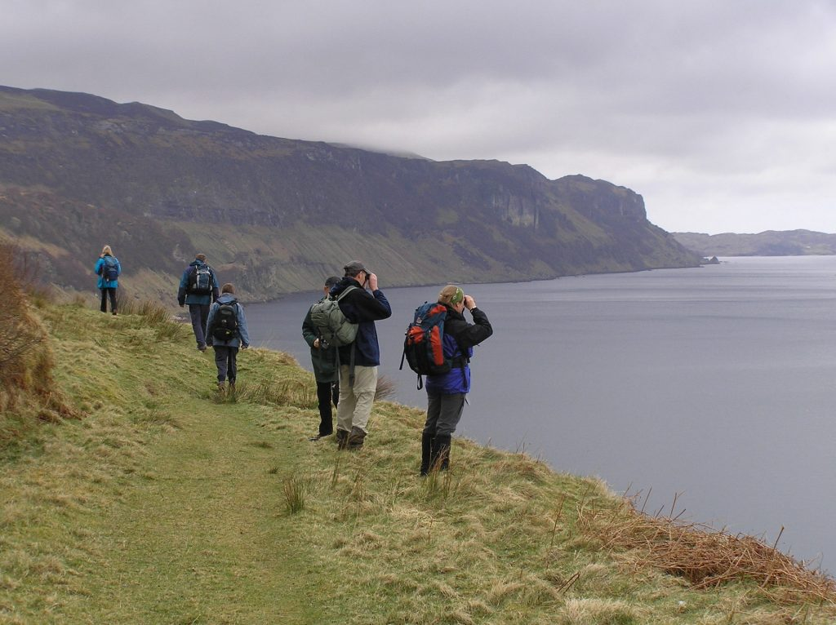
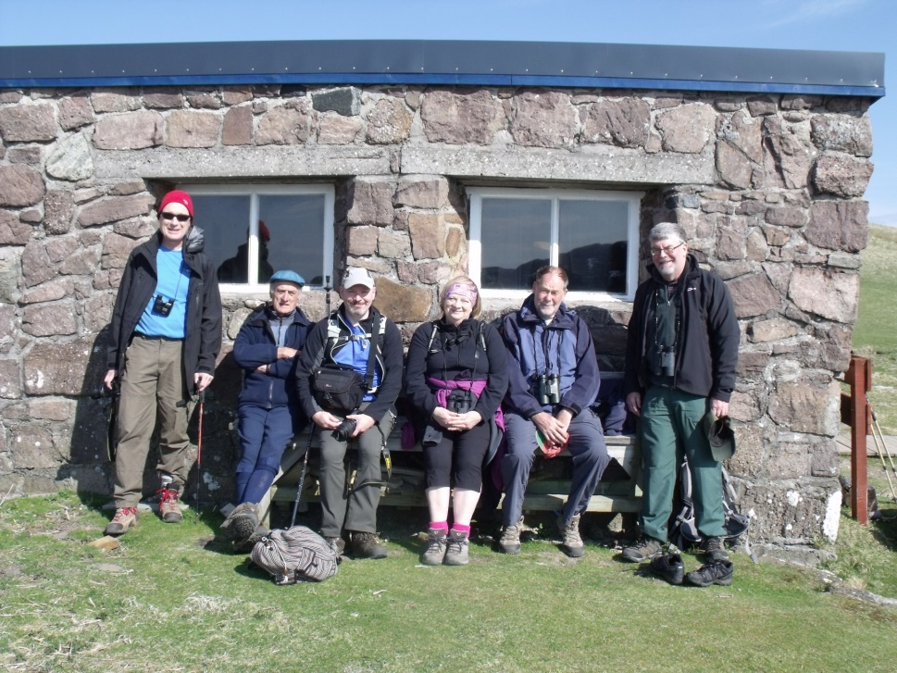
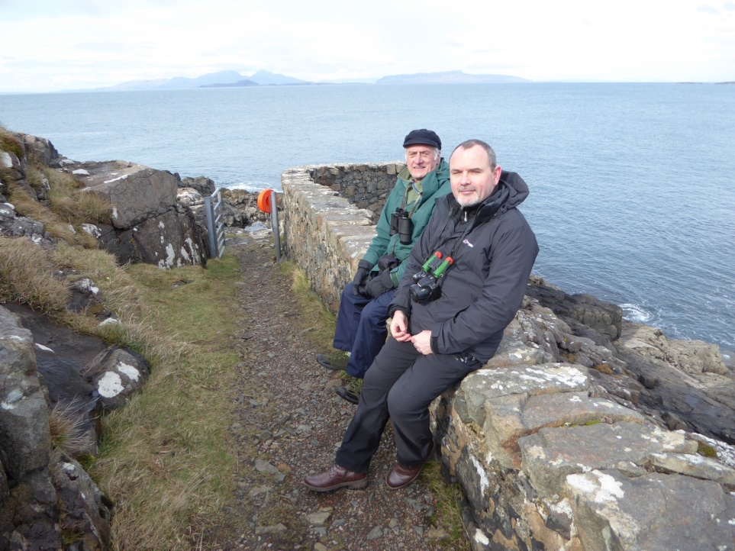
Easter activities
Birdwatching
Clockwise from top left : Raasay 2007, Dunoon 2012, Corran 2016, Handa 2014

Slide 10
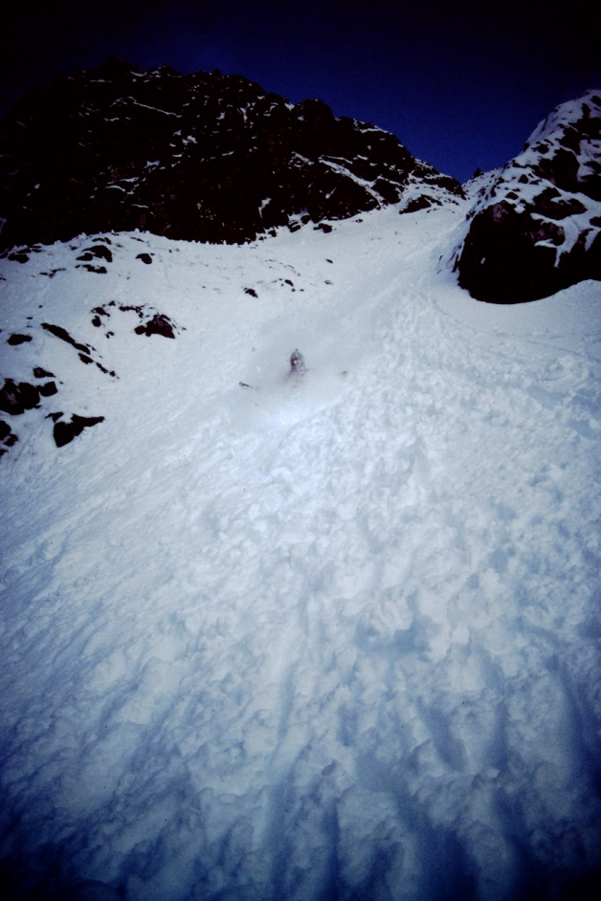
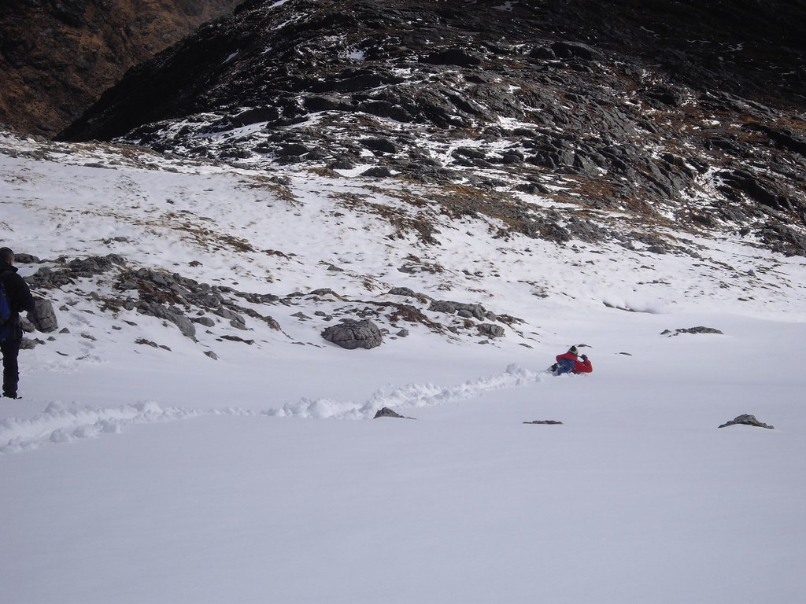
Easter activities
Fun and games in the snow
Glissading on Bidean nam Bean (1983) and Liz glissading on Gars Bheinn (2016)

Slide 11
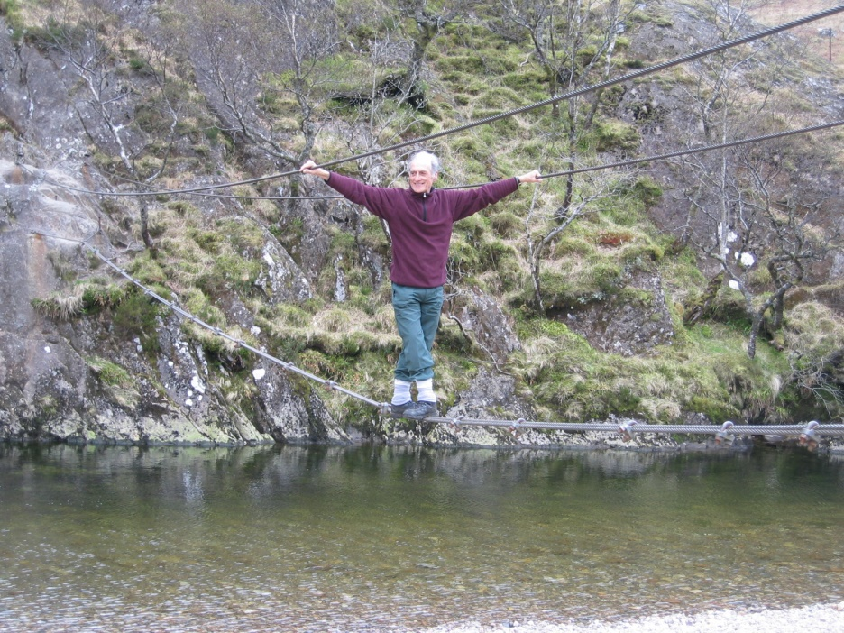
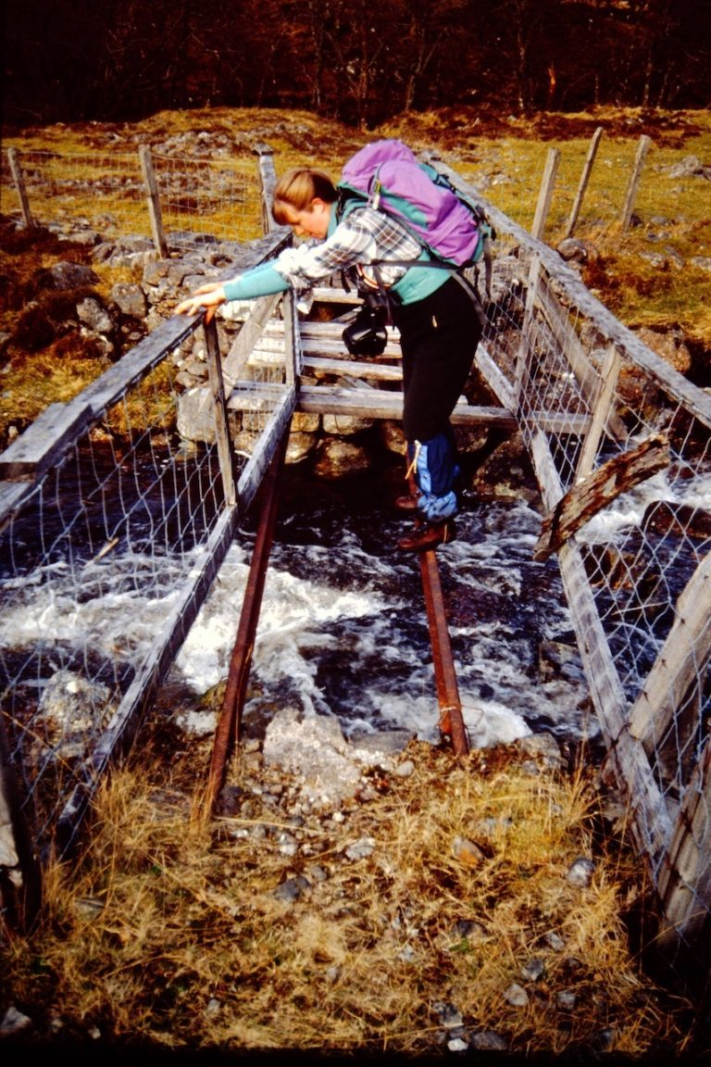
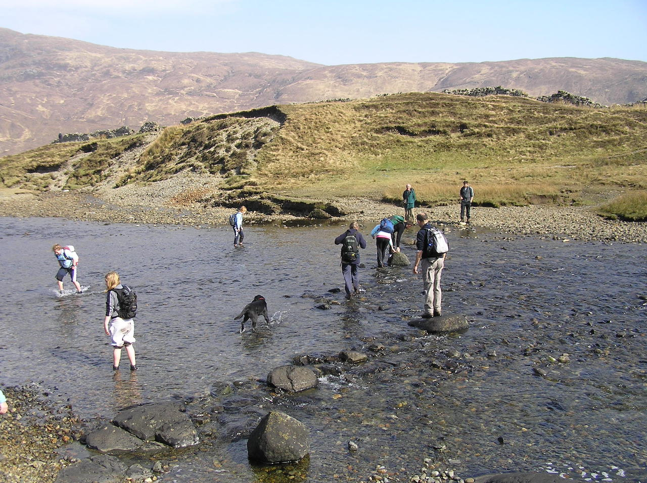
Easter activities
Fun and games - rivers and bridges
Above: Betsy –Falls of Glomach (1992)
Top right:Gordon C on Steall Bridge(2009)
Bottom right: Camasunary, Skye (2007)

Slide 12
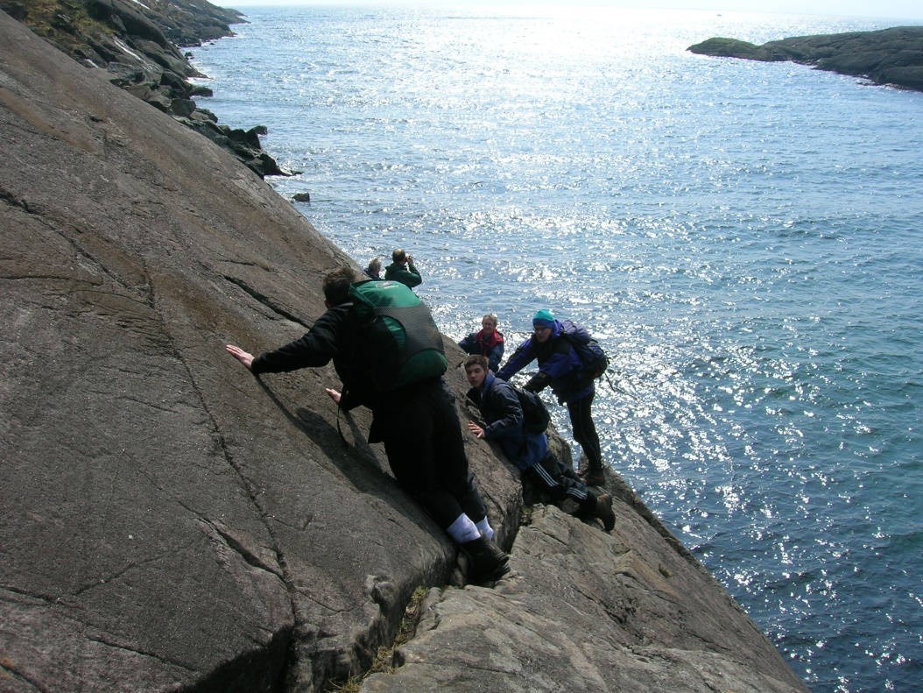
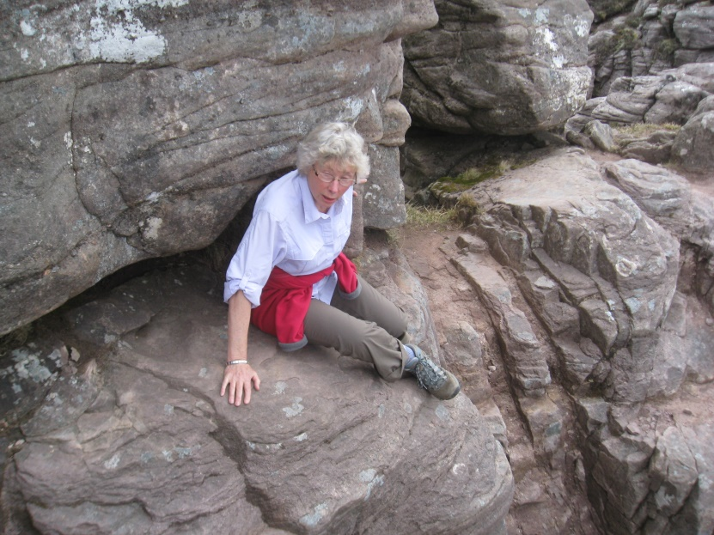
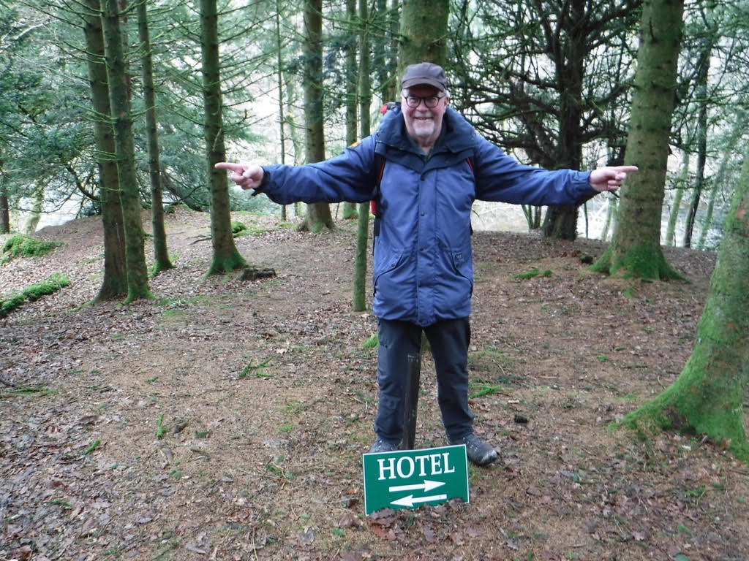
Easter activities
“Is this the right way?”
Top left – Pam negotiates a tricky ledge
Above – the bad step at Coruisk (2007)
Left – Bob is faced with a tricky decision (Ledgowan, 2018)

Slide 13
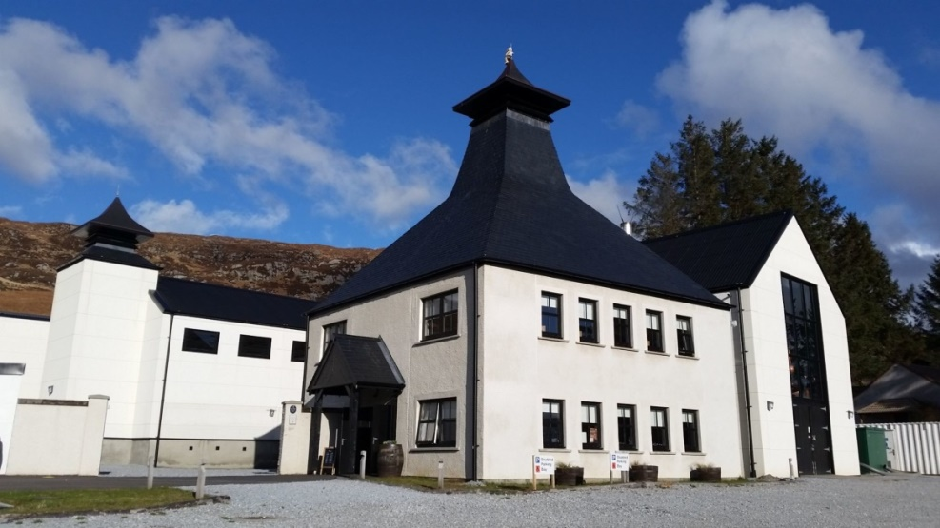
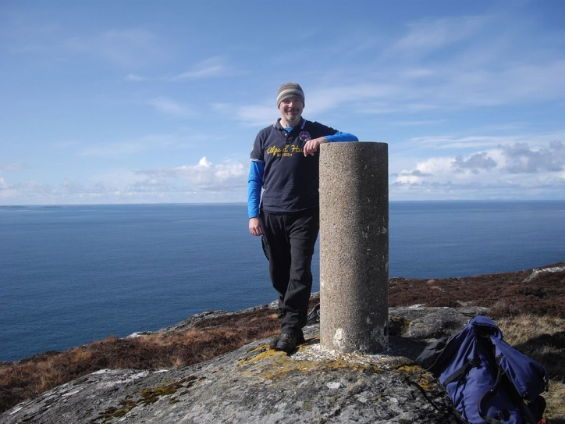
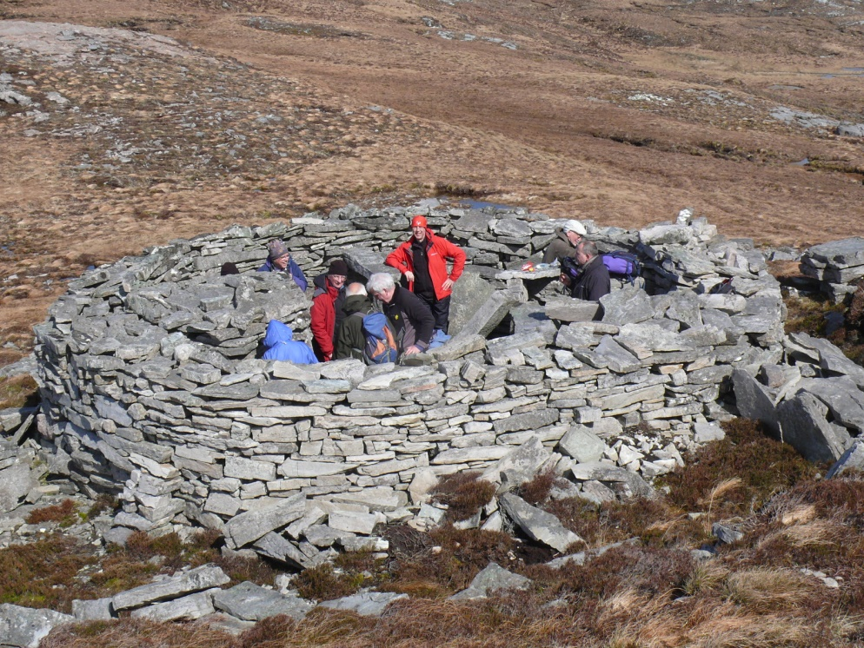
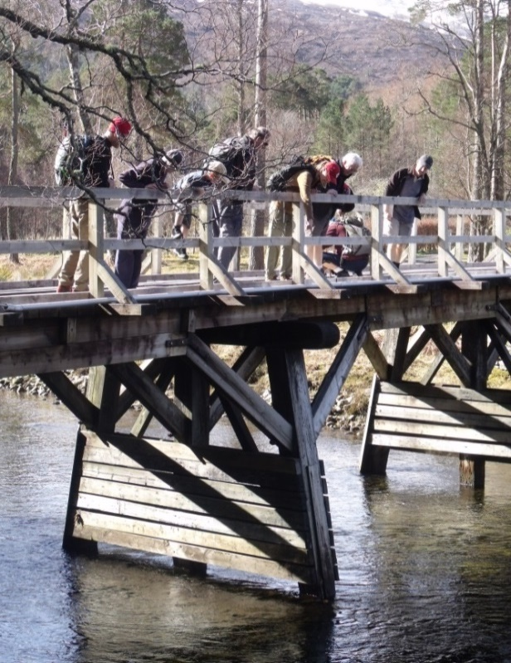
Easter activities
Pursuing other interests
Above: just one of the many distillery trips (this one is Ardnamurchan)
Top left: PhilS bags another trig point
Left: some ancient remains…. and an Iron Age fort (2016)
Right: playing Pooh sticks

Slide 14
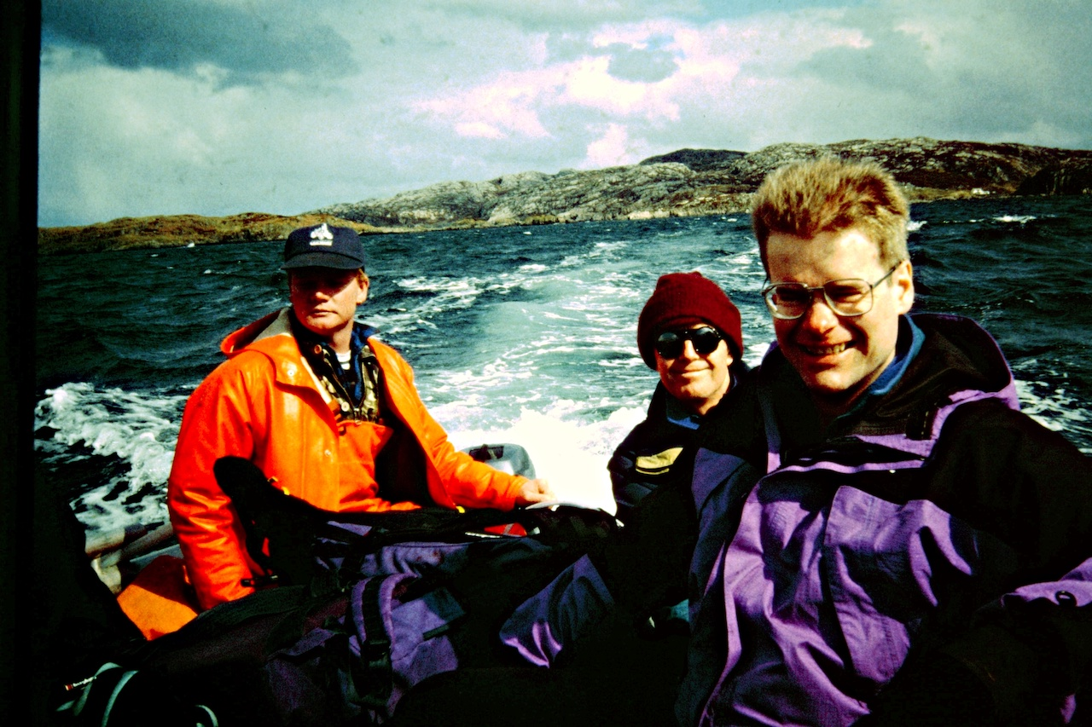
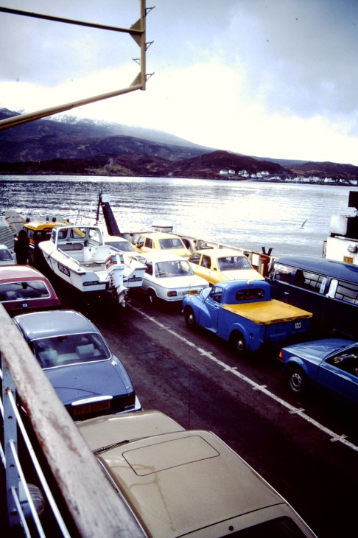
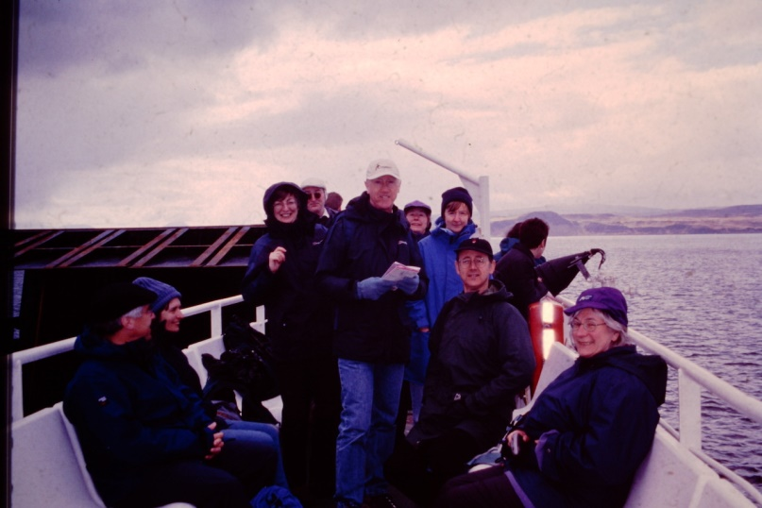
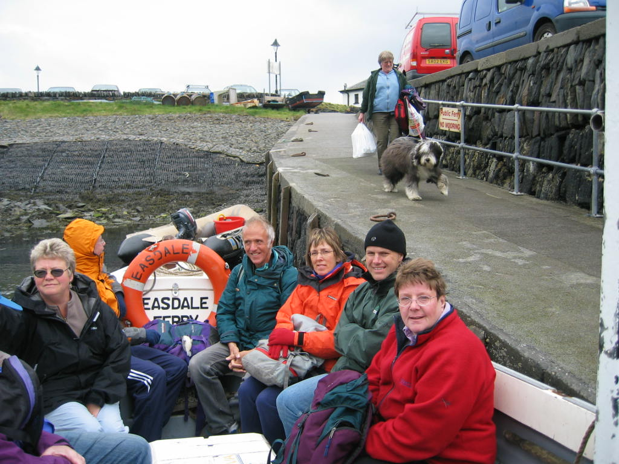
Easter activities
Ferries and Boat Trips
Above:Skye Ferry(1983)
Above: Boat to Handa (1998)
Left: Mull ferry (‘01)
Right: Seil Island(‘03)

Slide 15
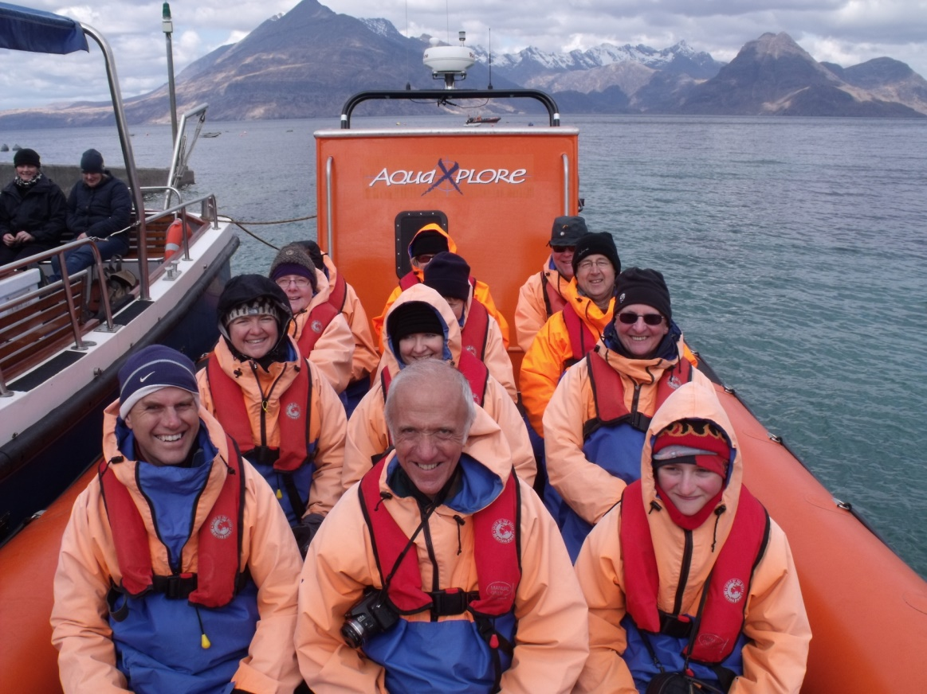
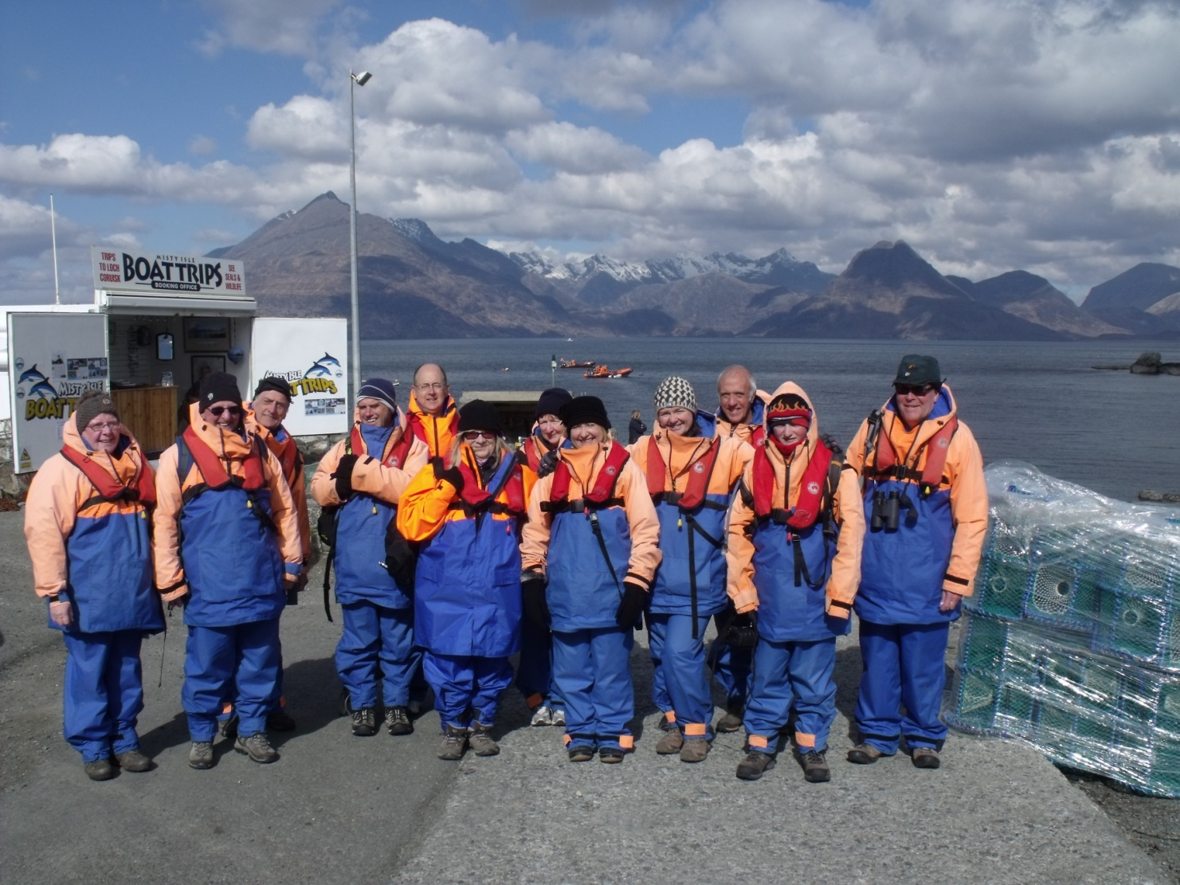
Easter activities
Ferries and Boat Trips
Cap’n Phil and crew
Loch Coruisk, Skye 2013

Slide 16
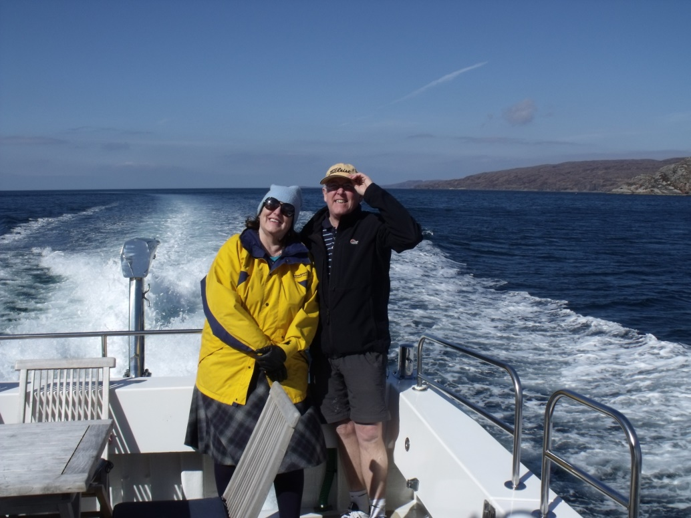
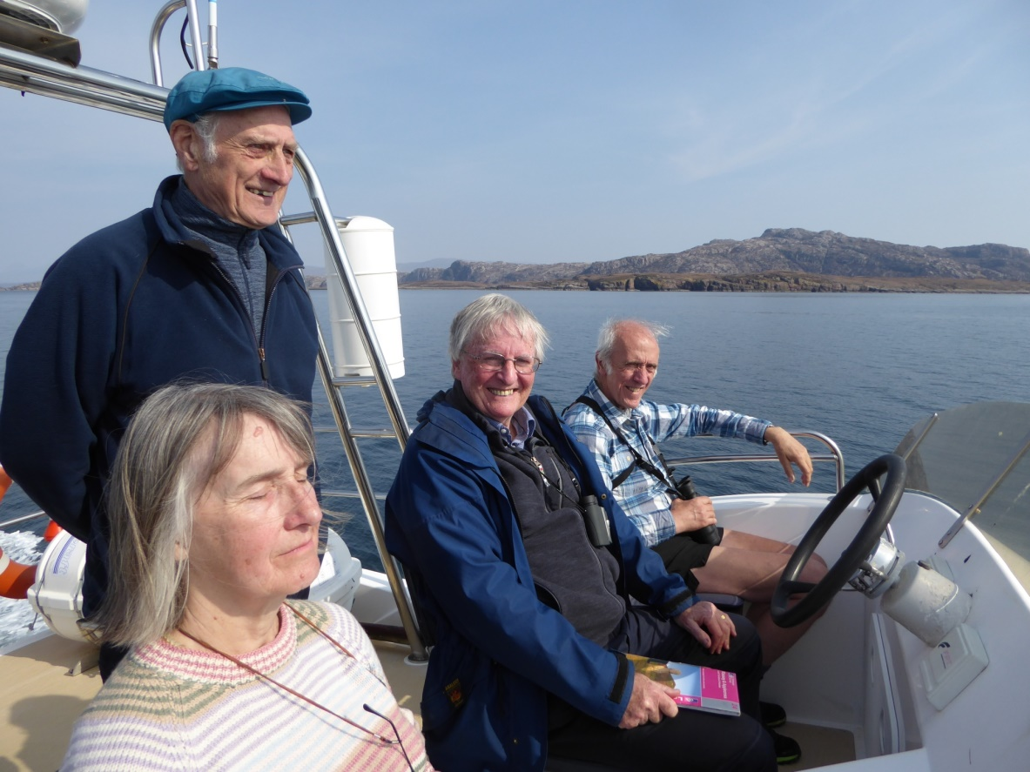
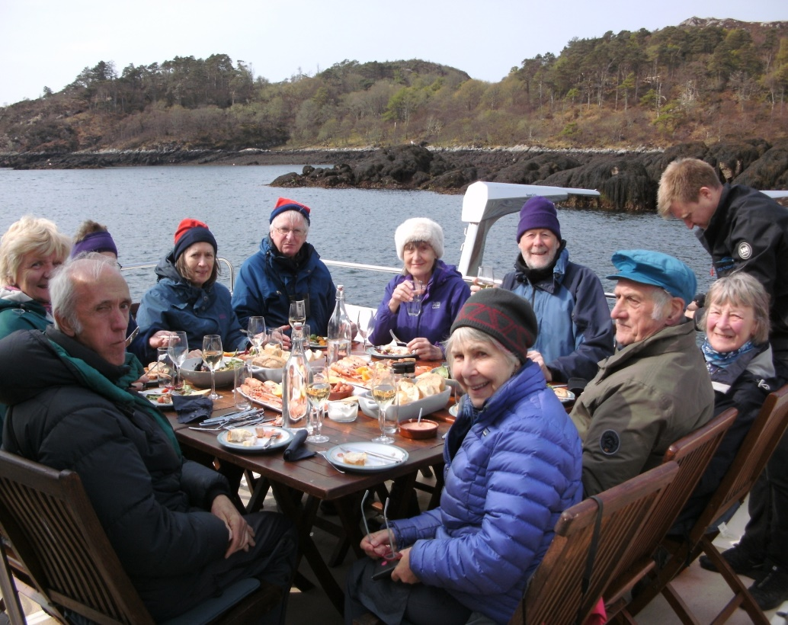
Easter activities
Ferries and Boat Trips
Right: Mandy & Richard cruising in style (2015)
Below: Sun and seafood (2019)

Slide 17
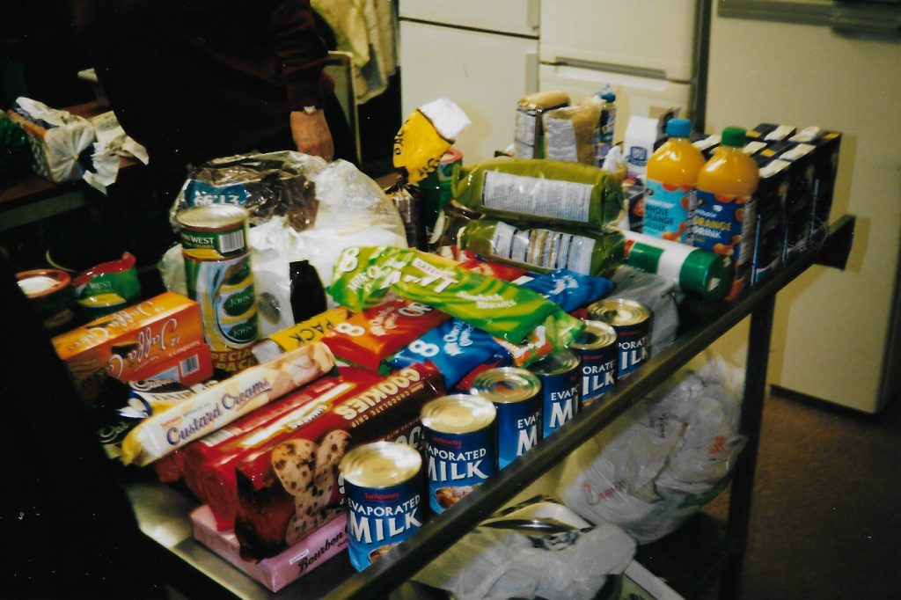
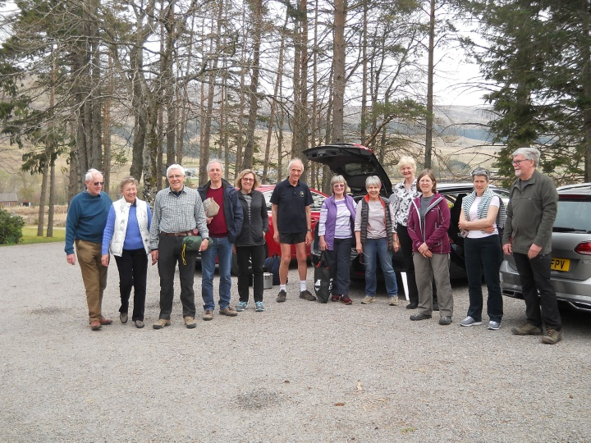
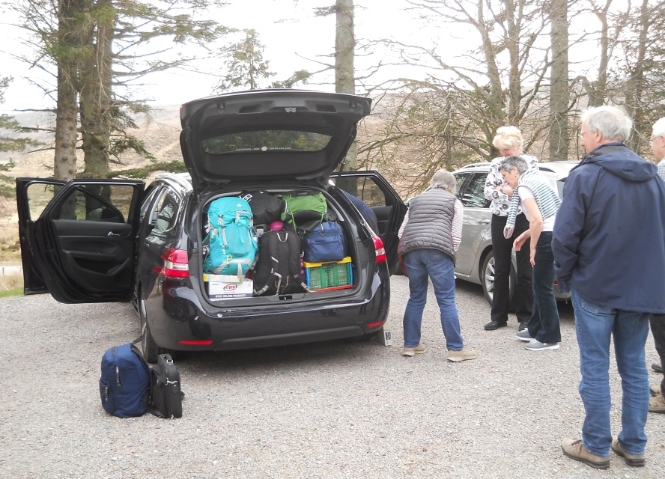
Easter tradition: the end of the week
Step 1: the leftovers
Step 2: group photo
Step 3: Jean discovers she’s travelling back to Bolton on the roof….

Slide 18
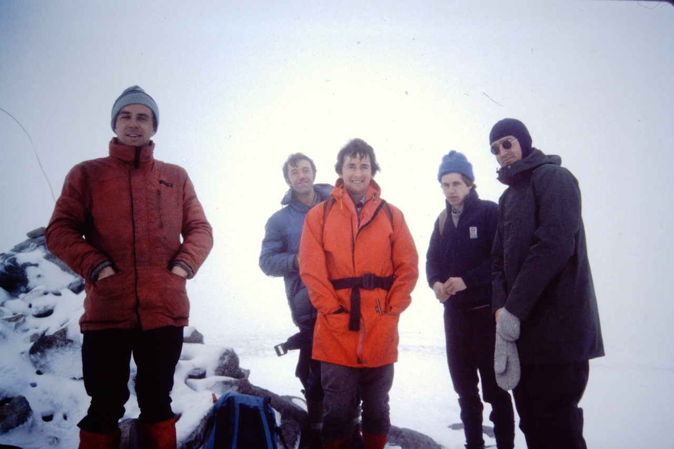
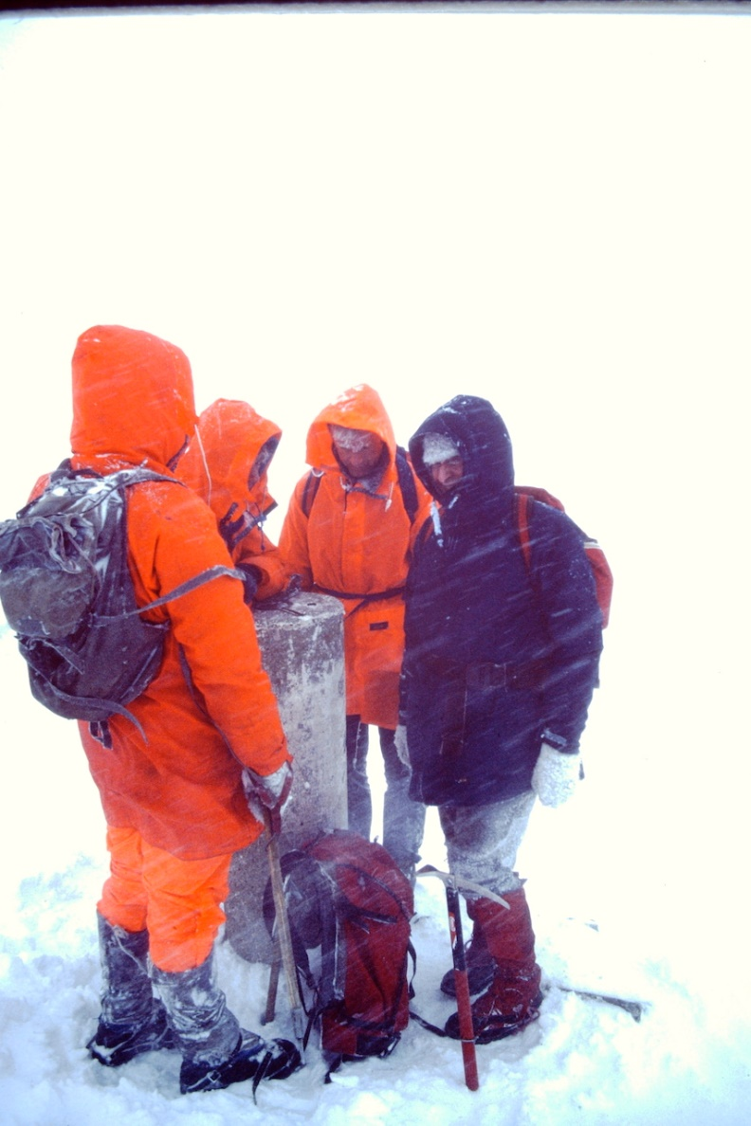
Hills and mountains……
In poor weather
Above: The Saddle (1983)
Top right: any ideas? (1985)
Bottom right: some summit or other (1998)

Slide 19
Hills and mountains……
In poor weather
Top left: Ben Lawers (2004)
Above: Slioch (2006)
Note: even Phil had waterproof trousers on that day…
Left: Ben Tirran in a white-out (2018) – John is still navigating his way to the summit trig …which Keira is standing on!

Slide 20
Hills and mountains……
In the sunshine – 1983
Above: Dave B on Ciste Dhubh
Top right: Dave K on the 5 Sisters
Bottom right: all too easy for these youngsters..

Slide 21
Hills and mountains……
In the sunshine – 1984 and 1986
Above: Anna and Mel on Ben Lomond
Below: Dave B on An Teallach
Gordon T in Torridon

Slide 22
Hills and mountains……
Bruach na Frithe, Skye, 2013
Cuillins, 2007
Sgurr na Banachdich, Skye, 2013
Suilven, 2014

Slide 23
Hills and mountains……
Gordon C on the path from Beinn Eighe (2015)
Jeanne, Skye (2007)
Clive gives his feet a rest - Ben Loyal (2016)
Liz, Heather and Peter on Liathach (2015)

Slide 24
Hills and mountains……
Above: Moruisg (2019);
Below: Rosemary – Trotternish, Skye(2007) Below : Cairnwell, Glenshee (2018)

Slide 25
Hills and mountains……
Jeanne and Dave K (1983)
Dave B and Brian on Beinn Eighe (1984)
Clive C, Lyn, David H and dogs (2019)

Slide 26
Food, glorious food
Right: eating out at Lochinver – 1998
Above: Dave “Two Soups” waiting on at Grandtully - 2004
Cluanie Lodge – 1980s

Slide 27
Food, glorious food
Above: Kinlochmoidart – 2001
The 1970’s originals cut the 30th anniversary cake
Local salmon – Kinlochbervie (2008)

Slide 28
Food, glorious food
Above: Dunoon 2012. Below: cooking at Hamara Lodge, Skye and at Glencanisp Lodge

Slide 29
Wildlife…
Feral goat (2016)
Skye seals (2007)
Matt and a friendly crab (2011)

Slide 30
Wildlife…
Deer, Ptarmigan, ‘Hielan Coo’ and
Reindeer

Slide 31
Seas, Lochs and Beaches
Above: Inverewe – 2006
Top right: Oldshoremore Bay – 2008
Bottom right: Camasunary – 2007

Slide 32
Seas, Lochs and Beaches
Above: Sandwood Bay (2008)
Top right: Jesper at Glendale (2013)
Bottom right: Handa Island (2014)

Slide 33
Seas, Lochs and Beaches
Spot the foghorn…
Cape Wrath - 2017
Smoo Cave, near Durness - 2017
Jill at Shieldaig - 2019

Slide 34
Youngsters…
Liz, Jonny and Harry - 2001
Keira and John, Dunoon - 2012

Slide 35
Youngsters….
William and Richard … and Liathach - 2015
Dib Dib Dib… the Elgin 49th Pack - 2021

Slide 36
A few more classic views
Kintail - 1983

Slide 37
The Needle, Quiraing, Skye
Torridon

Slide 38
The Inaccessible Pinnacle (InPin), Skye – 2013.
The previous day’s abseil training (round a tree) paid dividends...

Slide 39
Suilven - 2014
Ardnamurchan -2016

Slide 40
And now… back to the beginning
Bob M,Richard, Dave W, Phil and DaVe B - 1972

Slide 41
1970s

Slide 42
1970s

Slide 43
1970s

Slide 44
1970s

Slide 45
1970s

Slide 46
1970s

Slide 47
1970s

Slide 48
1970s

Slide 49
….here’s to the next 50!!

